Slide 1



Basic Numpy
Created by Tasya Amanda Adinegara
Notes:
Source image from https://realpython.com/python-conditional-statements/

Slide 2
What will we learn in this lesson (Objective)
1
Understanding What’s Numpy
2
Build Array
4
2D Numpy
3
Subsetting Numpy
5
Run Numpy for Statistics

Slide 3
Our Topics
What and Why Numpy
What’s Array
Build Array
Some Operation with Array
2DArray
Numpy for Statistics
Hands-On

Slide 4


What’s Numpy
Numpy adalah kependekan dari Numerical Python, sebuah library open source yang berisi objek array multidimensi.
Singkatnya : Numpy library di python untuk membuat / manipulasi a array multi dimensi.
Focus on
Build Array
Do some operations
Source:https://numpy.org/devdocs/user/absolute_beginners.html

Slide 5
Kenapa Numpy?
NumPy arrays lebih cepat dan lebih powerful dari python list.
NumPy menggunakan memori yang lebih sedikit.
Numpy > List

Slide 6
Jadi apa itu Array?

Slide 7
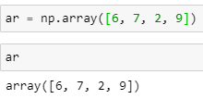
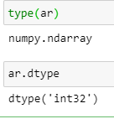
Array is…
Array adalah kumpulan atau himpunan atau kisi yang berisi informasi tentang raw data, yang terindeks dan bisa diakses nilainya, serta mendukung data multidimensi.
ndarray
An N-dimensional array is simply an array with any number of dimensions.

Slide 8
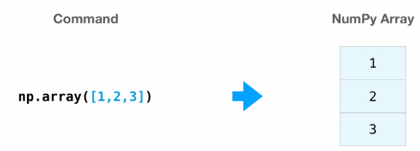







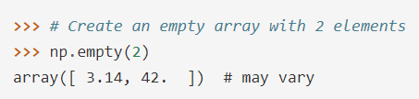
Build Array
1. np.array()
2. np.zeros()
5. np.arange()
7. Specifying your data type
3. np.ones()
6. np.linspace()
4. np.empty()

Slide 9



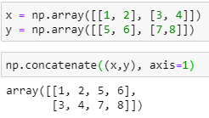

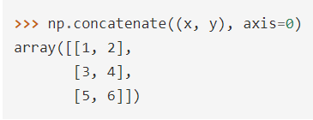
Adding and Sorting Elements
1. np.sort()
2. np.concatenate()

Slide 10
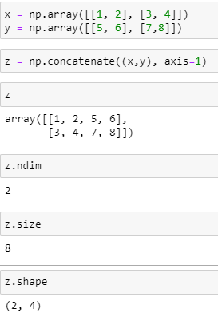
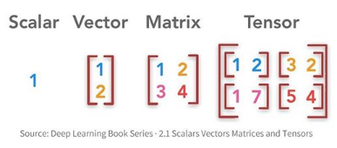
How do you know the shape and size of an array?
ndim
size
shape

Slide 11
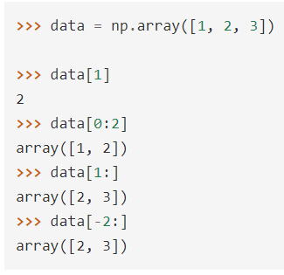
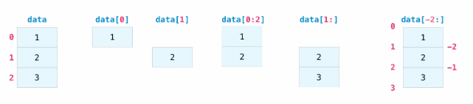
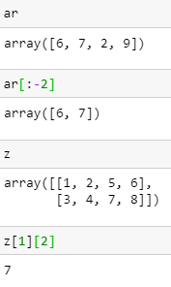
Indexing and Slicing

Slide 12


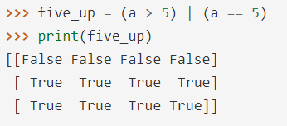

Indexing and Slicing (with Condition)

Slide 13
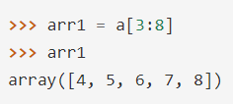
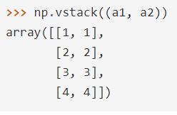
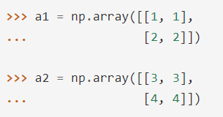

Create Array from Existing Data
1. Slicing
2. vstack() and hstack()

Slide 14
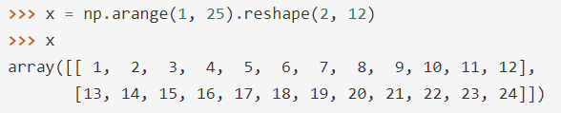
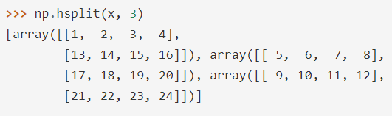
Create Array from Existing Data
3. hsplit()

Slide 15
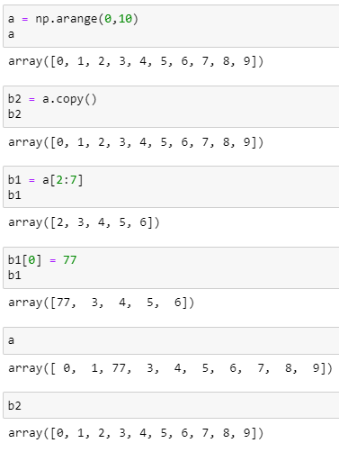
Create Array from Existing Data
3. copy()
Change
Not Change

Slide 16

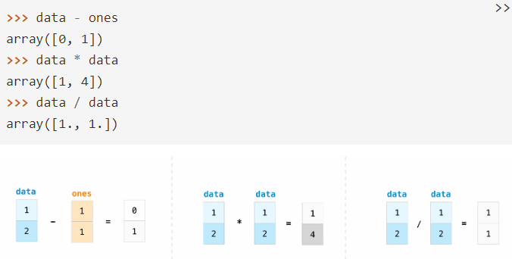
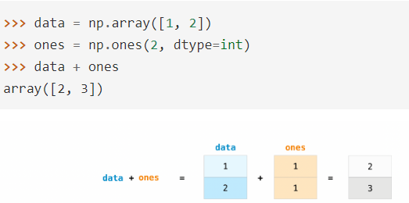
Basic Array Operations
Substraction, multiplication, division
Adding

Slide 17
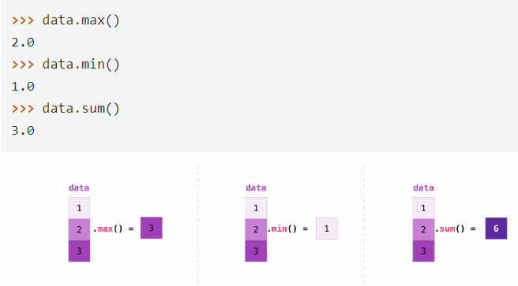
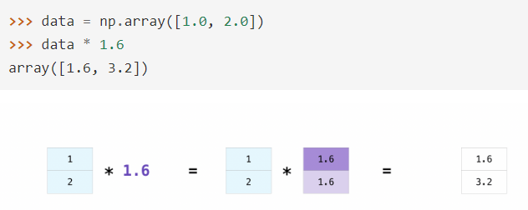
More useful array operations
min(), max(), sum()
Multiplication with scalar

Slide 18
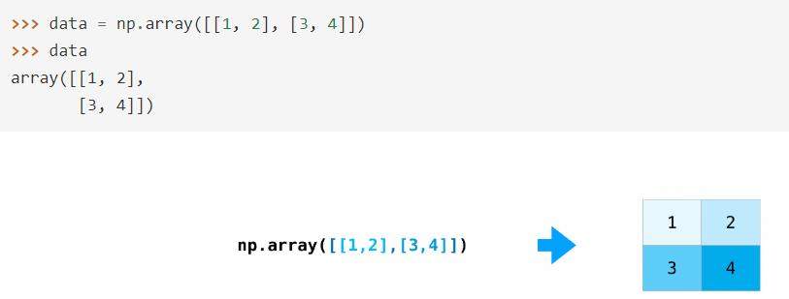
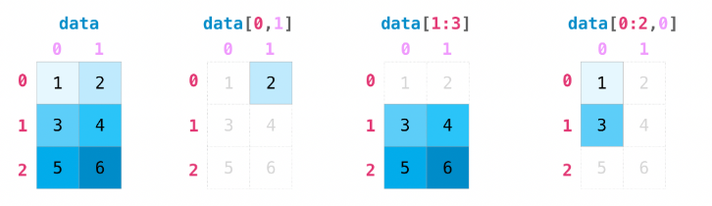
2D Array (Matrices)
Build
Indexing and Slicing

Slide 19
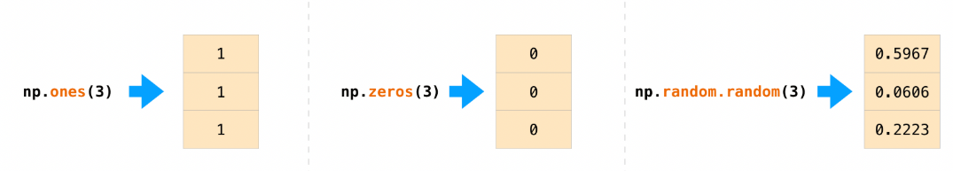
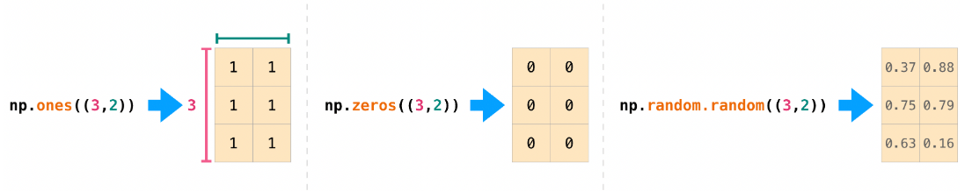
2D Array (Matrices)
Build Array

Slide 20
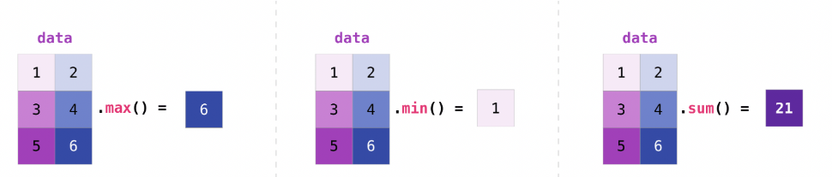
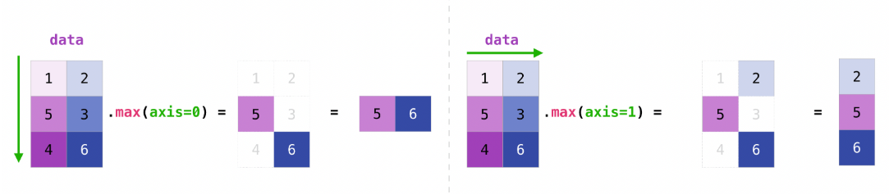
2D Array (Matrices)
Min, Max, Sum

Slide 21
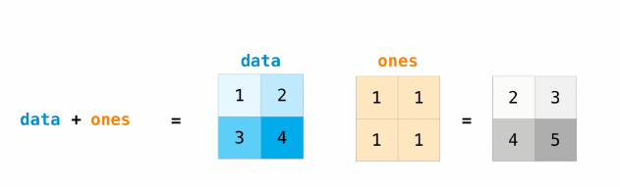
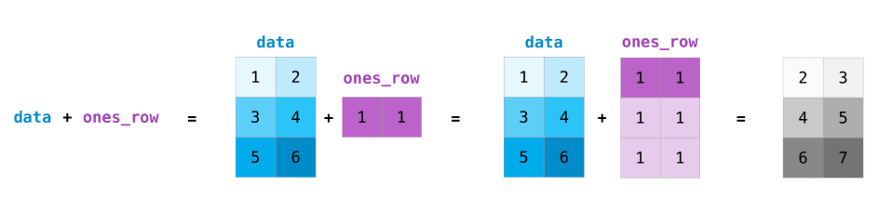
2D Array (Matrices)
Operation

Slide 22
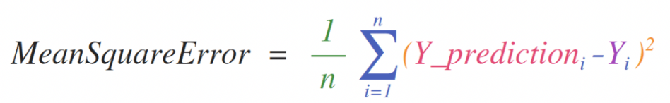
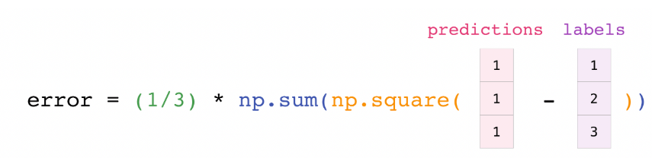
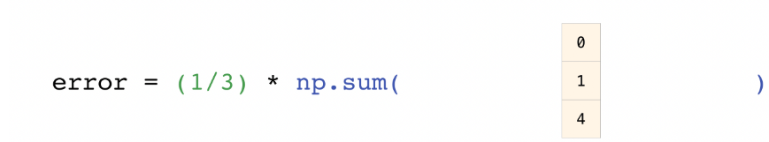
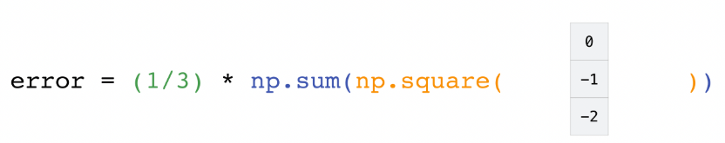

Implementation

Slide 23
Let’s go to Notebook

